Slide 1
Android Training
Interacting with Other Apps
http://developer.android.com/training/index.html
师文轩，13920561100，shiwenxuan2003@hotmail.com

Slide 2
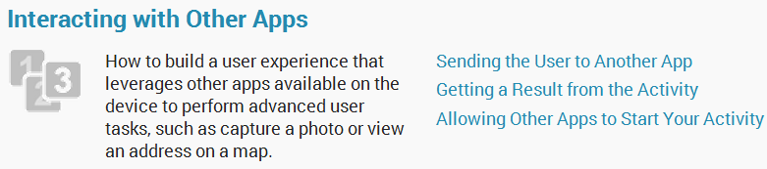
Interacting with Other Apps

Slide 3
Intro
To take the user from one activity to another, your app must use an Intent to define your app's "intent" to do something.
This class shows you how to use an Intent to perform some basic interactions with other apps, such as start another app, receive a result from that app, and make your app able to respond to intents from other apps.

Slide 4
Lessons
Sending the User to Another App
Getting a Result from an Activity
Allowing Other Apps to Start Your Activity

Slide 5
Sending the User to Another App
This lesson shows you how to create an implicit intent for a particular action, and how to use it to start an activity that performs the action in another app.

Slide 6
Build an Implicit Intent
Implicit intents do not declare the class name of the component to start, but instead declare an action to perform.
The action specifies the thing you want to do, such as view, edit, send, or get something.

Slide 7

For example, here's how to create an intent to initiate a phone call using the Uri data to specify the telephone number:

Slide 8
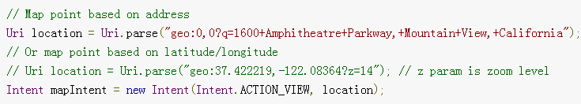

Here are a couple other intents and their action and Uri data pairs:
View a map:
View a web page:

Slide 9
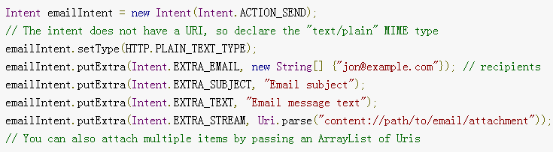
Here are some more intents that add extra data to specify the desired action:
Send an email with an attachment:

Slide 10
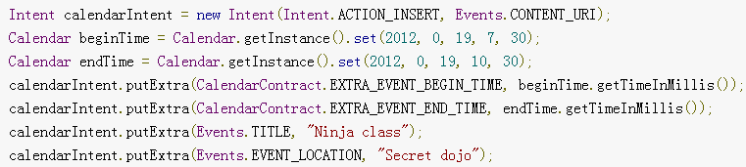
Create a calendar event:

Slide 11
Verify There is an App to Receive the Intent
Although the Android platform guarantees that certain intents will resolve to one of the built-in apps (such as the Phone, Email, or Calendar app), you should always include a verification step before invoking an intent.

Slide 12

To verify there is an activity available that can respond to the intent, call queryIntentActivities() to get a list of activities capable of handling your Intent. If the returned List is not empty, you can safely use the intent.
For example:

Slide 13
Start an Activity with the Intent
Once you have created your Intent and set the extra info, call startActivity() to send it to the system.

Slide 14
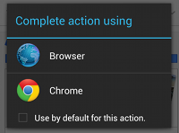
If the system identifies more than one activity that can handle the intent, it displays a dialog for the user to select which app to use.
If there is only one activity that handles the intent, the system immediately starts it.

Slide 15
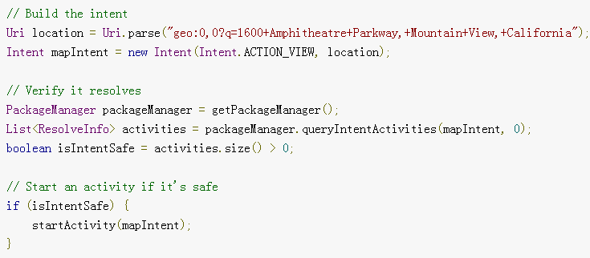
Here's a complete example that shows how to create an intent to view a map, verify that an app exists to handle the intent, then start it:

Slide 16
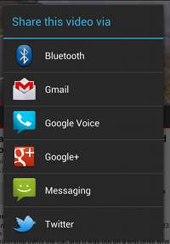
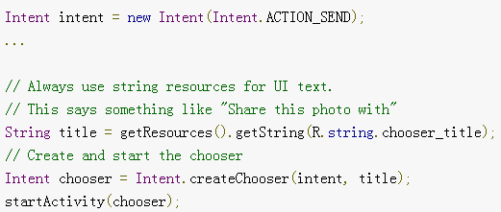
Show an App Chooser
To show the chooser, create an Intent using createChooser() and pass it tostartActivity().
For example:

Slide 17
Getting a Result from an Activity
Starting another activity doesn't have to be one-way. You can also start another activity and receive a result back.
To receive a result, call startActivityForResult() (instead of startActivity()).

Slide 18
Start the Activity
There's nothing special about the Intent object you use when starting an activity for a result, but you do need to pass an additional integer argument to the startActivityForResult() method.

Slide 19
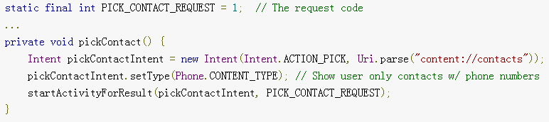
For example, here's how to start an activity that allows the user to pick a contact:

Slide 20
Receive the Result
When the user is done with the subsequent activity and returns, the system calls your activity's onActivityResult() method.
This method includes three arguments:
The request code you passed to startActivityForResult().
A result code specified by the second activity.
An Intent that carries the result data.

Slide 21
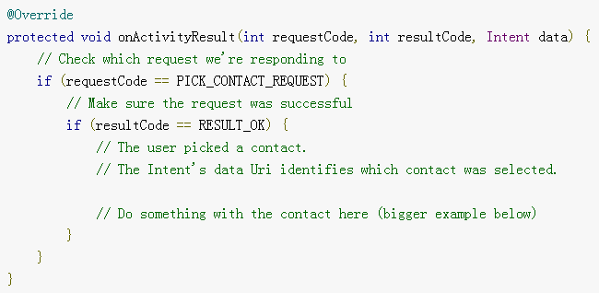
For example, here's how you can handle the result for the "pick a contact" intent:

Slide 22
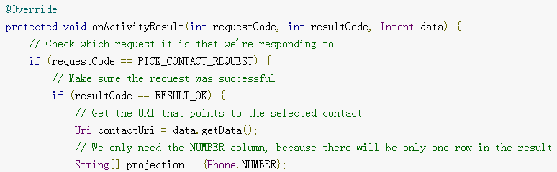
Bonus: Read the contact data
here's some more code that shows how to query the result data to get the phone number from the selected contact:

Slide 23
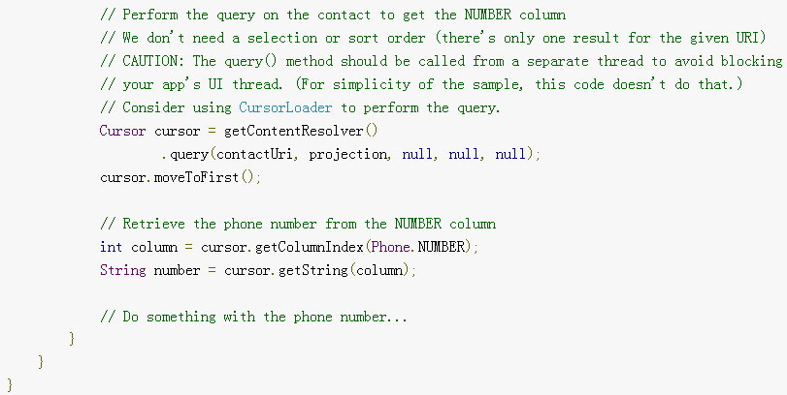

Slide 24
Allowing Other Apps to Start Your Activity
To allow other apps to start your activity, you need to add an<intent-filter> element in your manifest file for the corresponding <activity> element.

Slide 25
Add an Intent Filter
In order to properly define which intents your activity can handle, each intent filter you add should be as specific as possible in terms of the type of action and data the activity accepts.

Slide 26
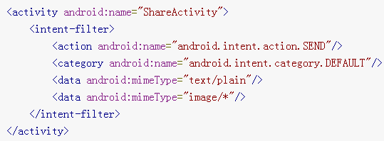
For example, here's an activity with an intent filter that handles the ACTION_SEND intent when the data type is either text or an image:

Slide 27
If any two pairs of action and data are mutually exclusive in their behaviors, you should create separate intent filters to specify which actions are acceptable when paired with which data types.

Slide 28
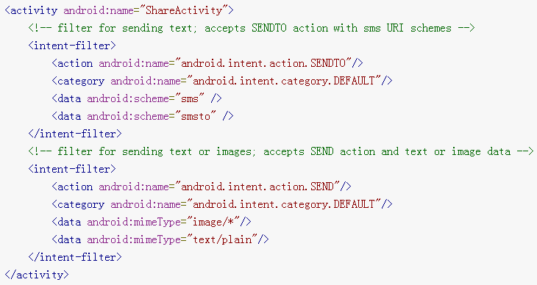
For example:

Slide 29
Handle the Intent in Your Activity
In order to decide what action to take in your activity, you can read the Intent that was used to start it.

Slide 30
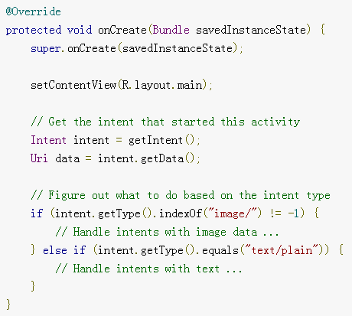
For example:

Slide 31
Return a Result
If you want to return a result to the activity that invoked yours, simply call setResult() to specify the result code and result Intent.
When your operation is done and the user should return to the original activity, callfinish() to close (and destroy) your activity.

Slide 32
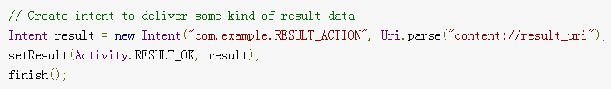
For example:
You must always specify a result code with the result. Generally, it's either RESULT_OK or RESULT_CANCELED. You can then provide additional data with an Intent, as necessary.

